Slide 1
Diabetes Classification
IBM Machine Learning Professional Certificate Supervised Machine Learning: Classification
Name – PAULAMI SANYAL
July 2023

Slide 2
OBJECTIVE
The objective of this assignment is to predict the occurrence of Diabetes, based on diagnostic measurements of many previous cases.
Our model will try to learn from the available records of the previously diagnosed patients and classify new unknown patients with similar records, whether they have diabetes or not

Slide 3
DATA SUMMARY
Several constraints were placed on the selection of these instances from a larger database. In particular, all patients here are females at least 21 years old of Pima Indian heritage.
Pregnancies: Number of times pregnant
Glucose: Plasma glucose concentration a 2 hours in an oral glucose tolerance test
BloodPressure: Diastolic blood pressure (mm Hg)
SkinThickness: Triceps skin fold thickness (mm)
Insulin: 2-Hour serum insulin (mu U/ml)
BMI: Body mass index (weight in kg/(height in m)^2)
DiabetesPedigreeFunction: Diabetes pedigree function
Age: Age (years)
Outcome: Class variable (0 or 1)

Slide 4
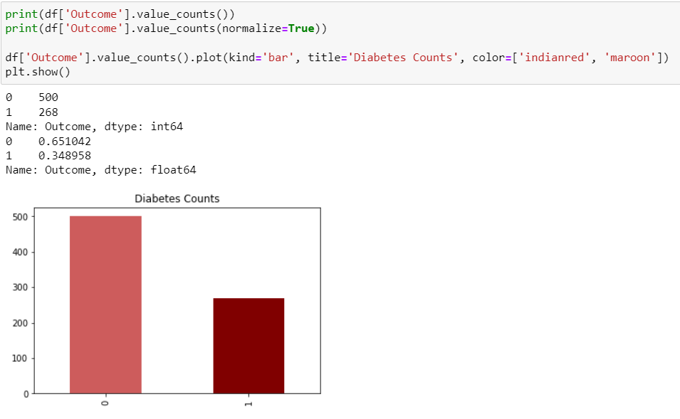
DATA EXPLORATION
In our dataset, we have 8 features and one target variable ‘Outcome’. The target variable ‘Outcome’ is classified into 2 categories, 1 for those patients who has diabetes and 0 for those patients who do not have diabetes.
Count-wise, 500 patients do not have diabetes and 268 patients do have diabetes. Percent-wise, about 65% do not have diabetes, and about 35% have diabetes.

Slide 5
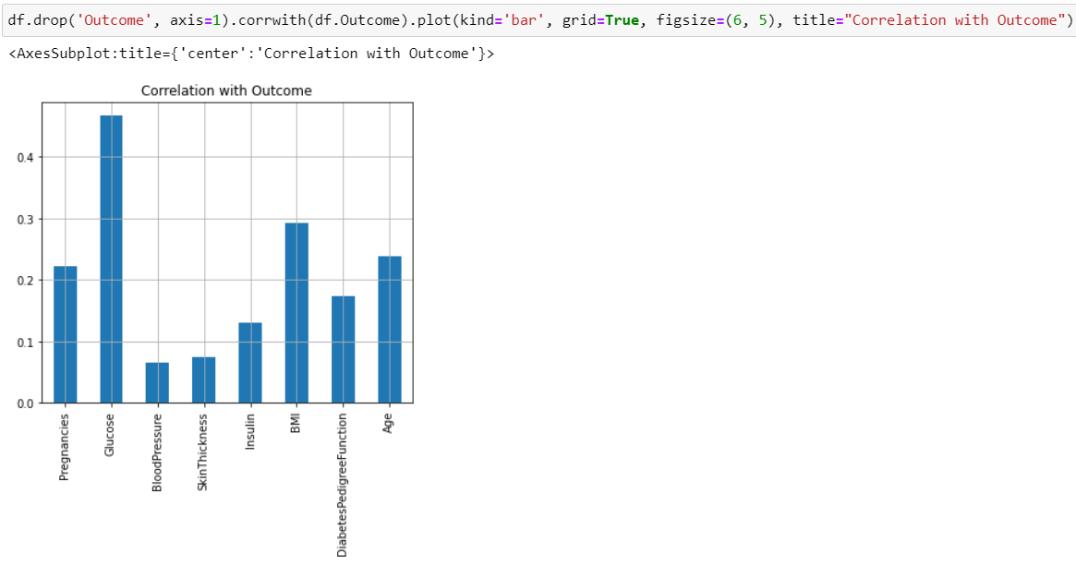
DATA EXPLORATION
As we can see from the bar plot of the correlations of the features with the ‘Outcome’, the features that have highest correlation with the target are ‘Glucose’, BMI’, ‘Age’, and ‘Pregnancies’.

Slide 6
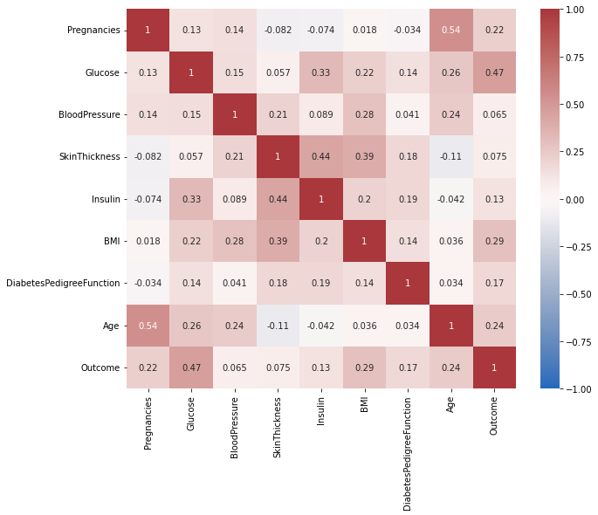
DATA EXPLORATION
Heatmaps are used to find correlations between all the feature variables in the dataset.
As we can see, ‘Glucose’ and ‘BMI’ both have higher correlations with our target variable ‘Outcome’.
‘SkinThickness’ and ‘Age’ have negative correlation. Meaning, as there is an increase in age, there’s a decrease in ‘SkinThickness’.

Slide 7
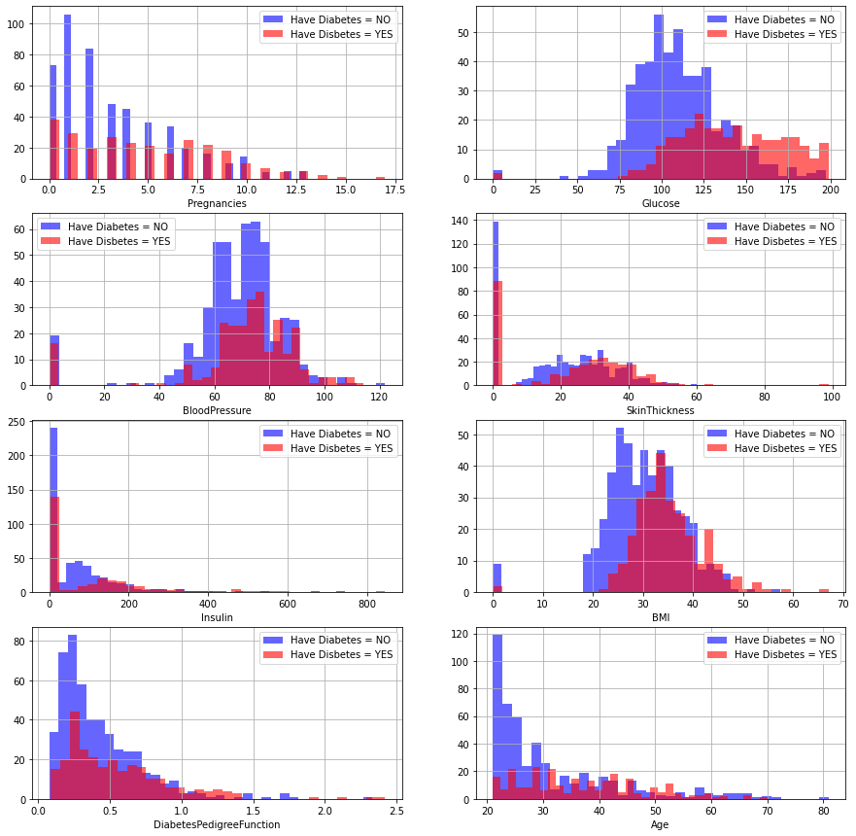
DATA EXPLORATION
Here we see the distributions of occurrence of diabetes amongst various given features.

Slide 8
DATA CLEANING & FEATURE ENGINEERING
The dataset came with 8 features. And all of them were continuous in nature.
However, some of the features had much higher values than the others. Hence, we had to normalize the data.
We normalized the data after splitting it, and performed fit_transform() function only on the X_train, and then performed only transform() function on X_test to avoid overfitting.

Slide 9
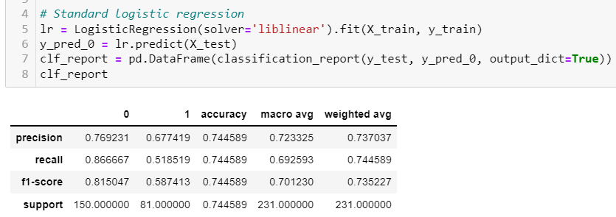
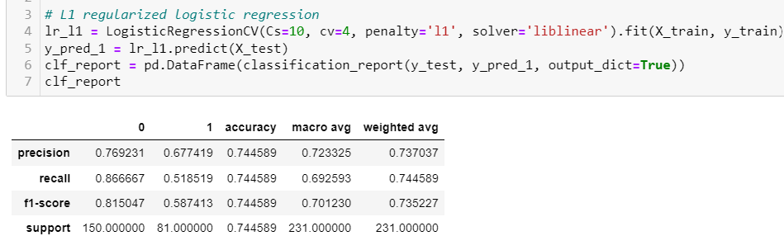
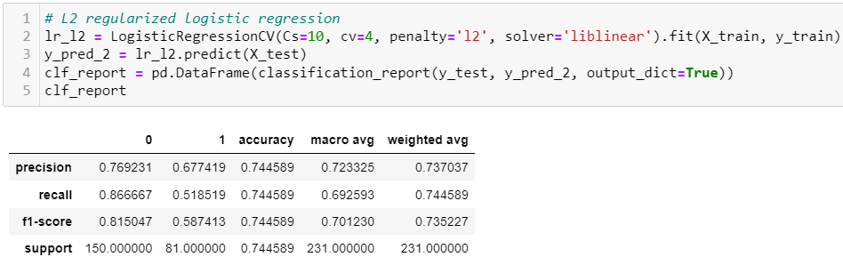
CLASSIFIER MODELS
LOGISTIC REGRESSION - We built 3 models with Logistic Regression – a standard one without regularization, one with L1 regularization and one with L2 regularization. All the models gave us similar scores. So, it’s safe to say here regularization isn’t really required.

Slide 10
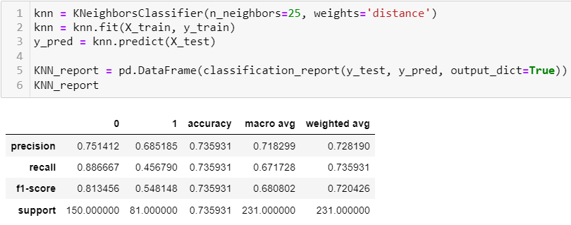
CLASSIFIER MODELS
KNN Algorithm – We also built a KNN model on the data.

Slide 11
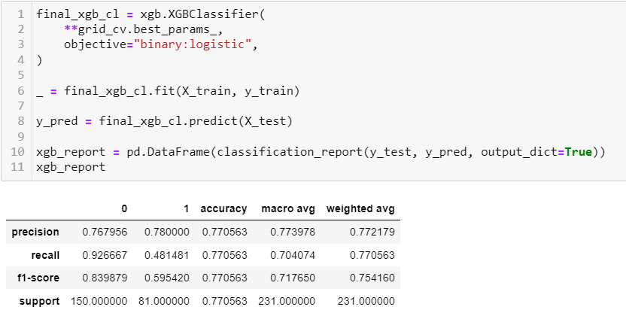
CLASSIFIER MODELS
XGBoost Classifier Algorithm – We also used XGBoost as one of the models for the dataset.

Slide 12
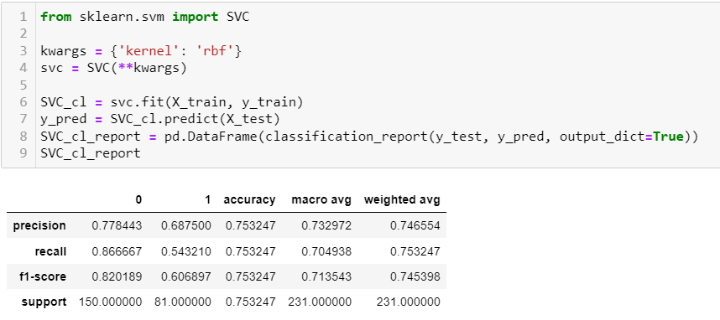
CLASSIFIER MODELS
SVC algorithm – We built a support vector classifier model as well for the dataset.

Slide 13
RECOMMENDATION
If we are making classification of diseases, Recall (or Sensitivity) would be the ideal score to use as a metric for decision-making.
In our models, we find that Support Vector Classifier gave us the highest Recall value of about 54%.
The close second would be Logistic Regression, with or without any regularization.
My recommendation would be to use Support Vector Classifier in this case.

Slide 14
SUGGESTIONS/NEXT STEPS
As we can see from the metrics obtained from the model classification report, our Recall scores were quite low. A recall value of less than 0.5 could be due to imbalanced class or untuned hyperparameters. We can further inspect the features for class imbalance and perform resampling, oversampling or undersampling or simply using class_weight as a parameter in the models, wherever applicable.
We can also look for another feature like family history of diabetes in the patient to further improve the model.

Slide 15
THANK YOU!
Source: kaggle.com

